Slide 1
Chapter 12
Sorting
Objectives
Upon completion you will be able to:
Understand the basic concepts of internal sorts
Discuss the relative efficiency of different sorts
Recognize and discuss selection, insertion and exchange sorts

Slide 2
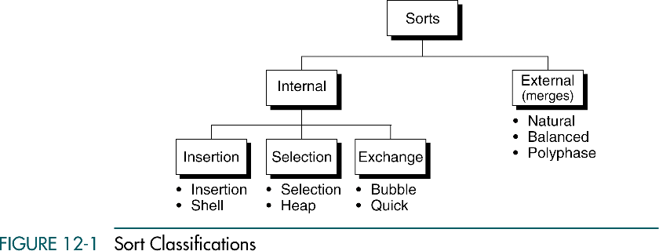

Slide 3
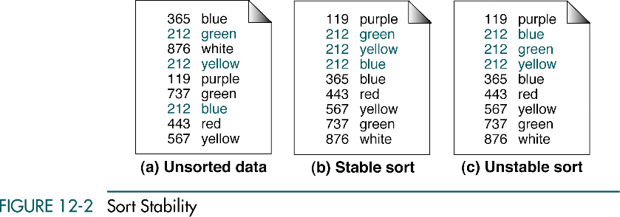

Slide 4
12-2 Selection Sorts
In each pass of the selection sort, the smallest element is selected from the unsorted sublist and exchanged with the element at the beginning of the unsorted list. We discuss two classic selection sorts, straight selection and heap sort.
Straight Selection Sort
Heap Sort
Selection Sort Efficiency
Selection Sort Implementation

Slide 5
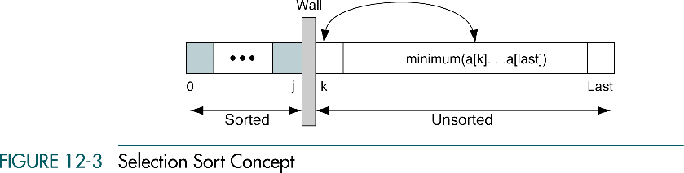

Slide 6
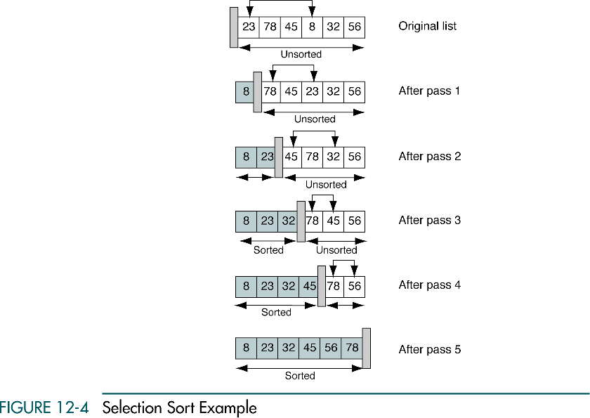

Slide 7
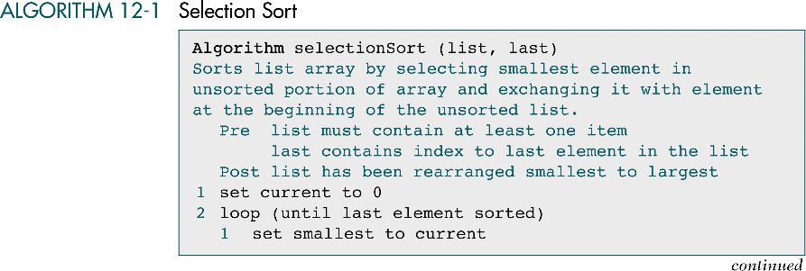

Slide 8
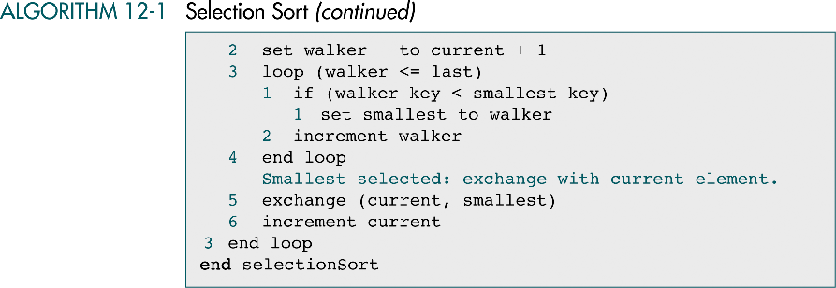

Slide 9
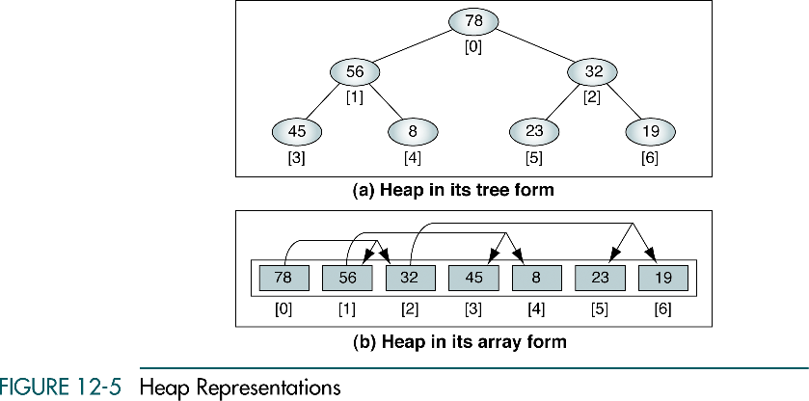

Slide 10
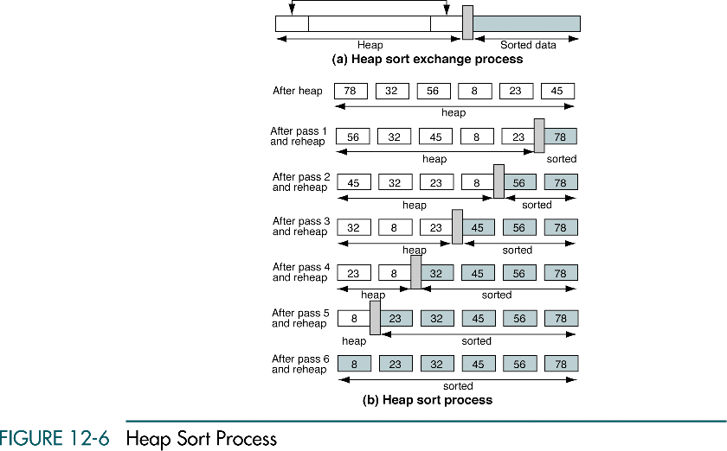

Slide 11
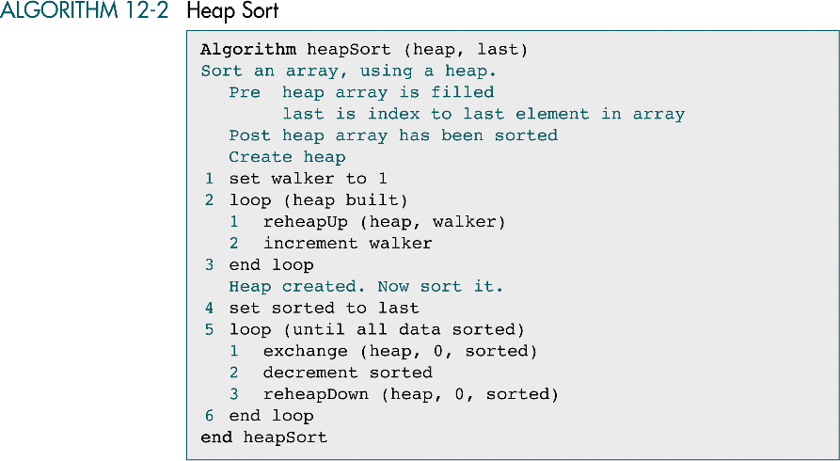

Slide 12
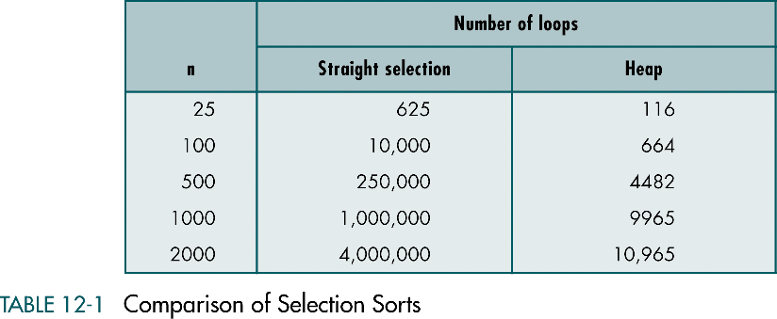

Slide 13
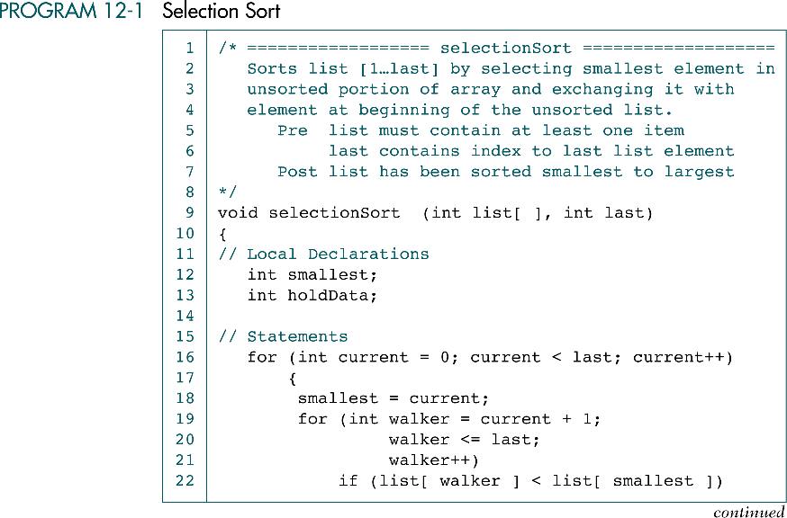

Slide 14
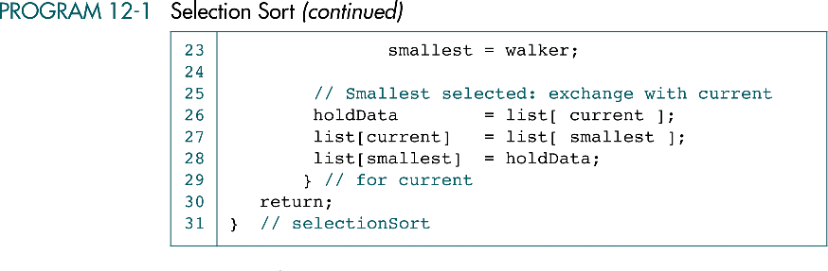

Slide 15
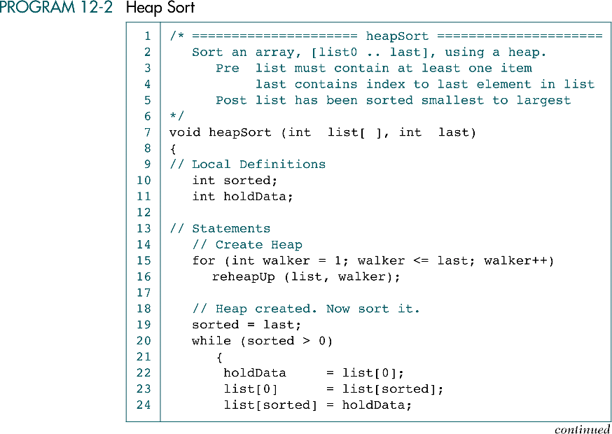

Slide 16
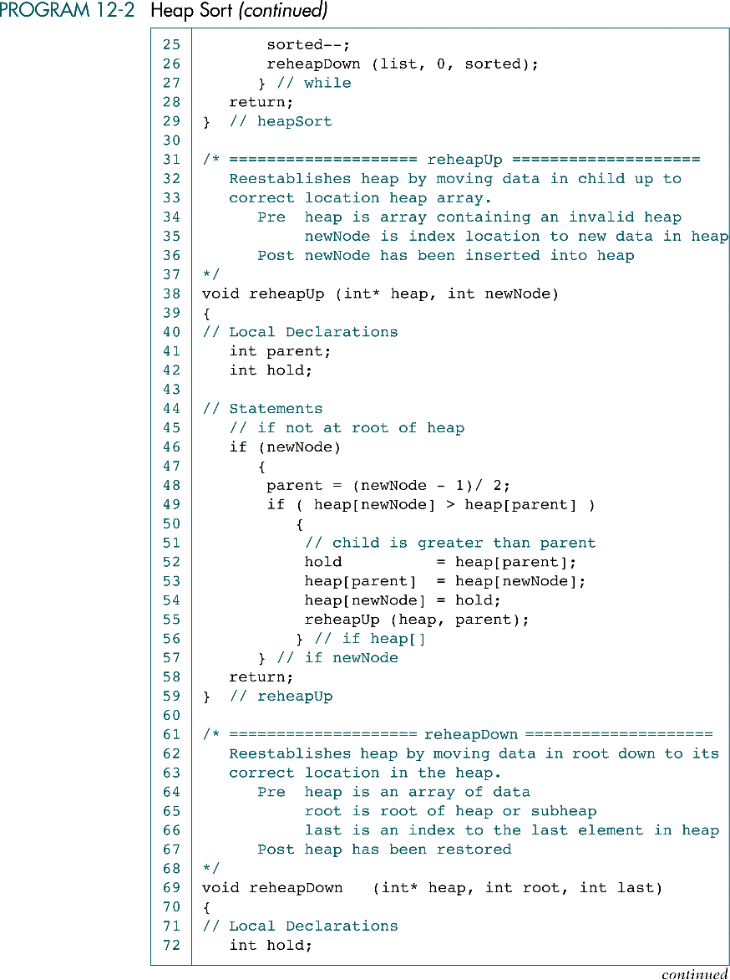

Slide 19
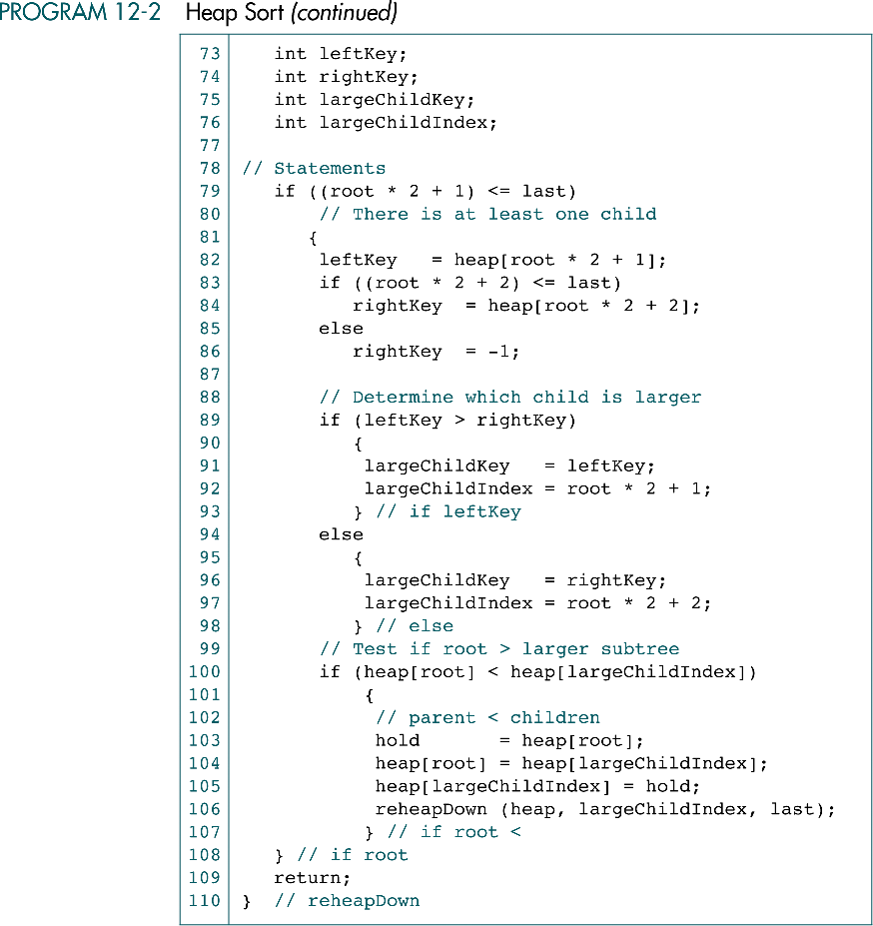

Slide 21
12-3 Insertion Sorts
In each pass of an insertion sort, one or more pieces of data are inserted into their correct location in an ordered list. In this section we study two insertion sorts: the straight insertion sort and the shell sort.
Straight Insertion Sort
Shell Sort
Insertion Sort Efficiency
Insertion Sort Implementation

Slide 22
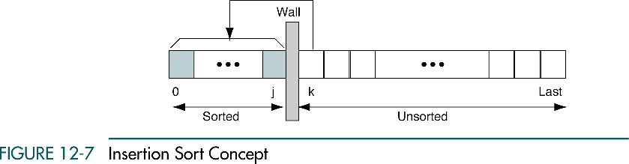

Slide 23
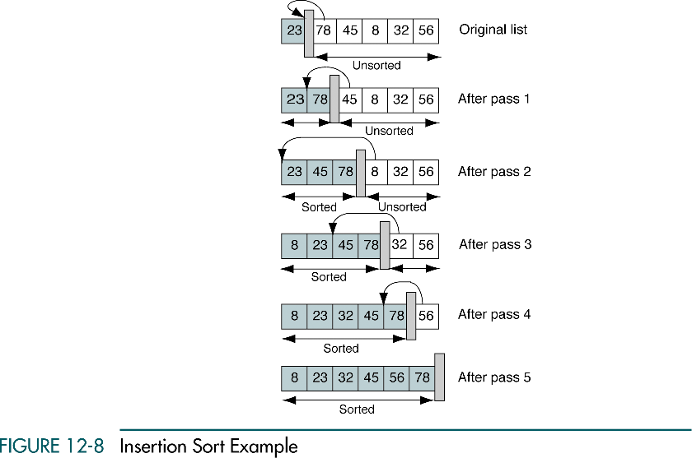

Slide 24
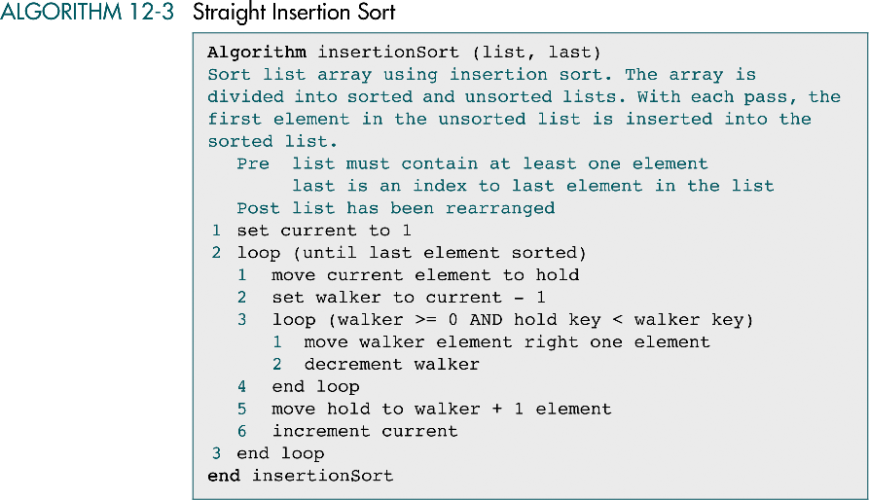

Slide 25
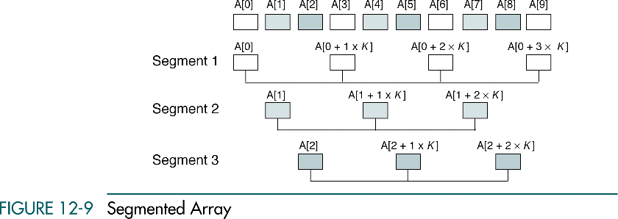

Slide 26
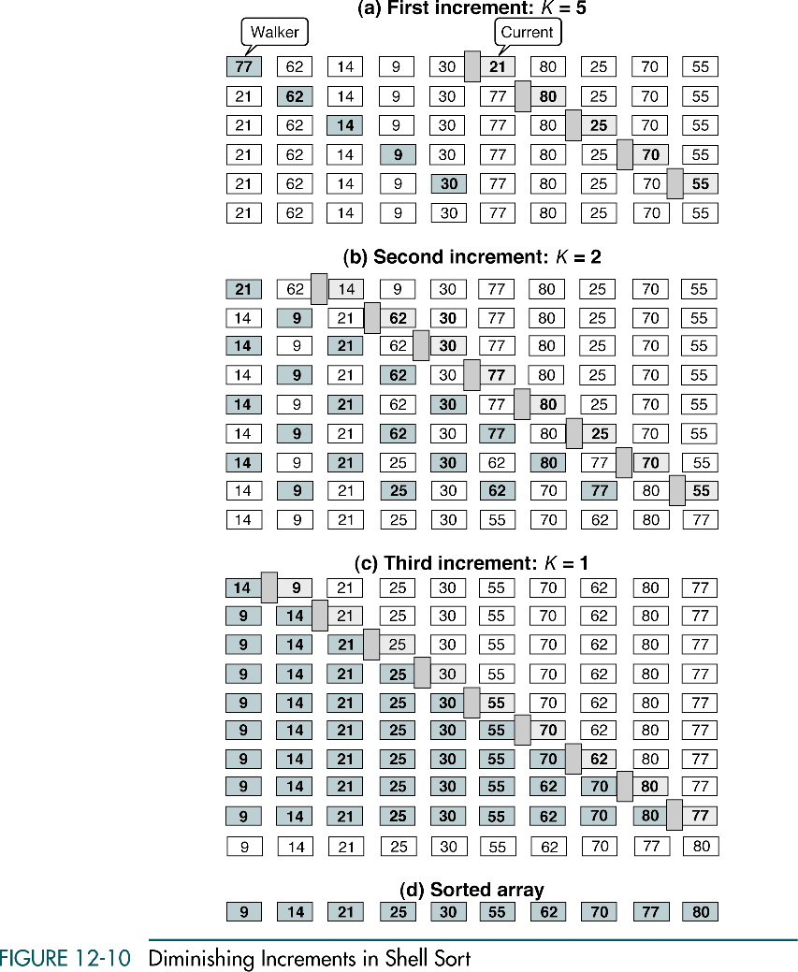

Slide 27
(continued)

Slide 28
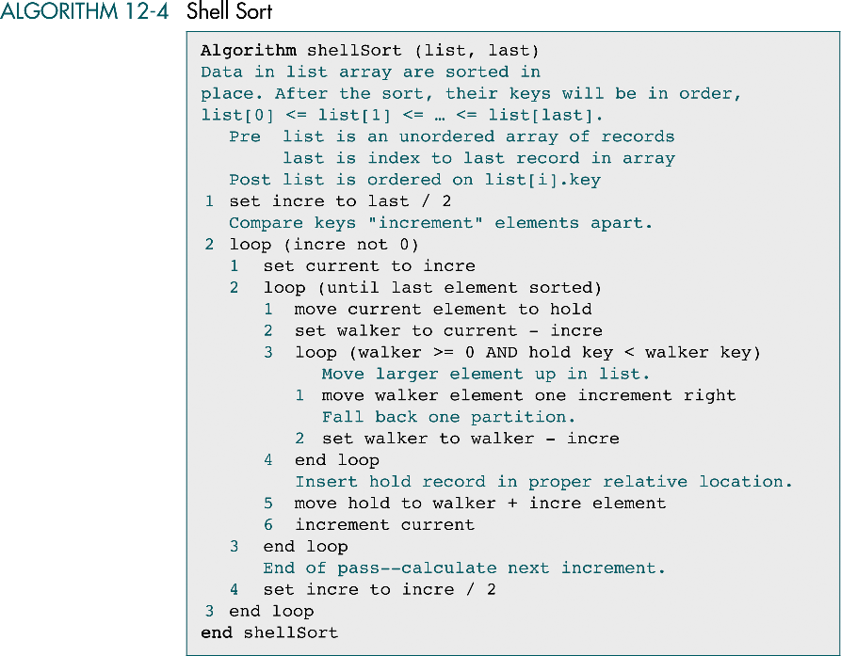

Slide 29
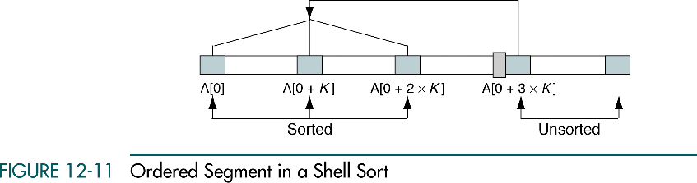

Slide 30
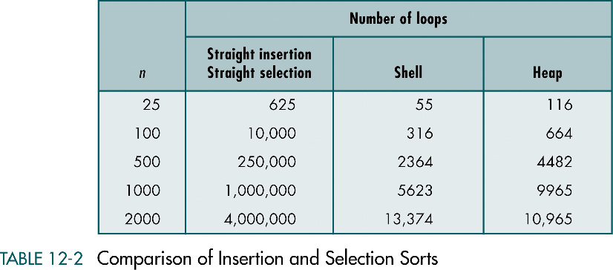

Slide 31
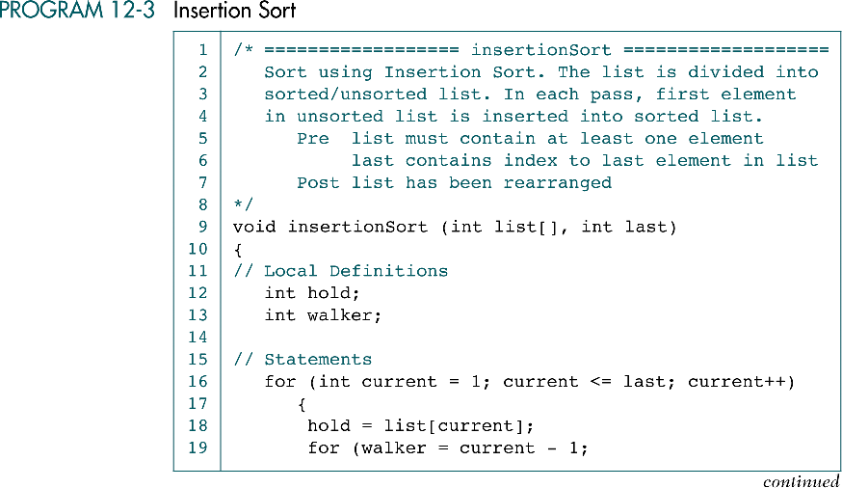

Slide 32
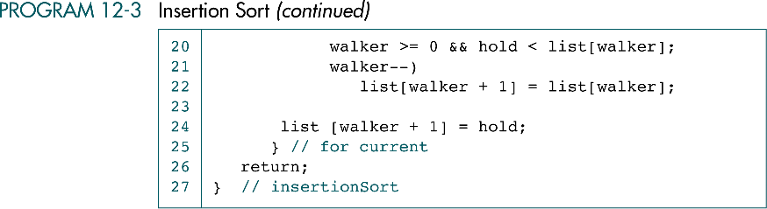

Slide 33
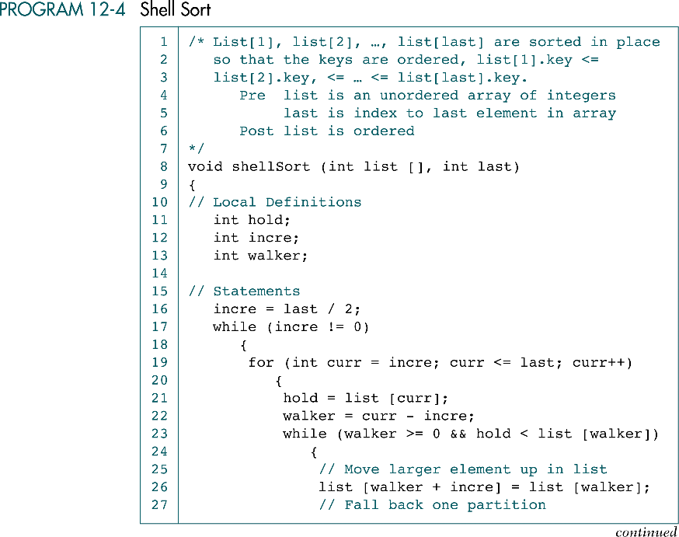

Slide 34
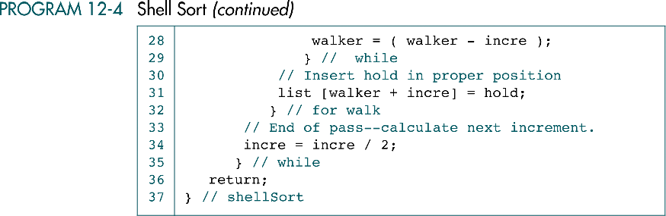

Slide 35
12-4 Exchange Sorts
This section discusses the four basic queue operations. Using diagrammatic figures, it shows how each of them work. It concludes with a comprehensive example that demonstrates each operation.
Bubble Sort
Quick Sort
Exchange Sort Efficiency
Sort Summary
Exchange Sort Implementation

Slide 36
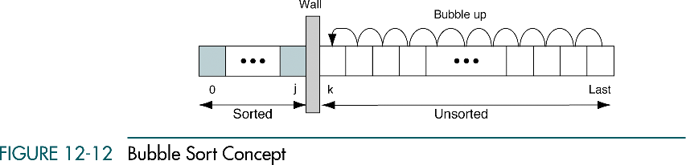

Slide 38
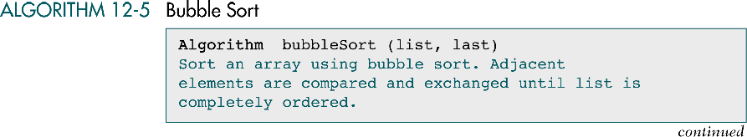

Slide 39
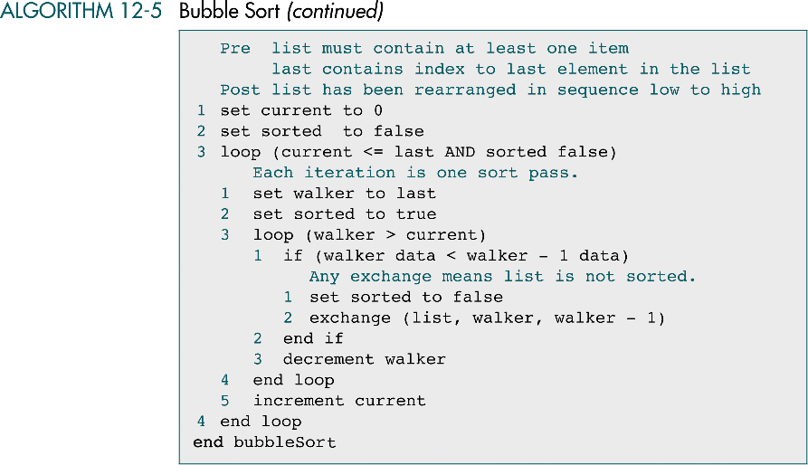

Slide 40
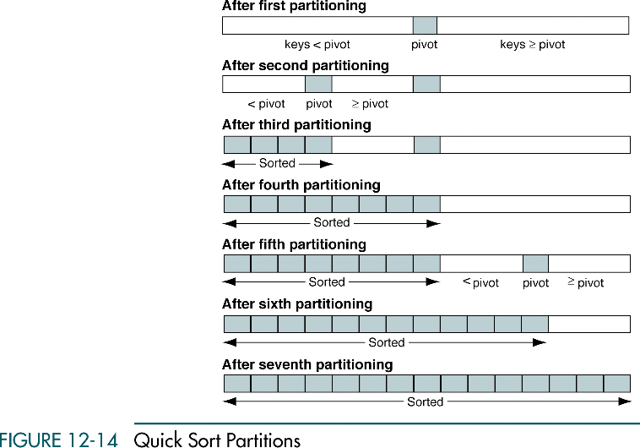

Slide 41
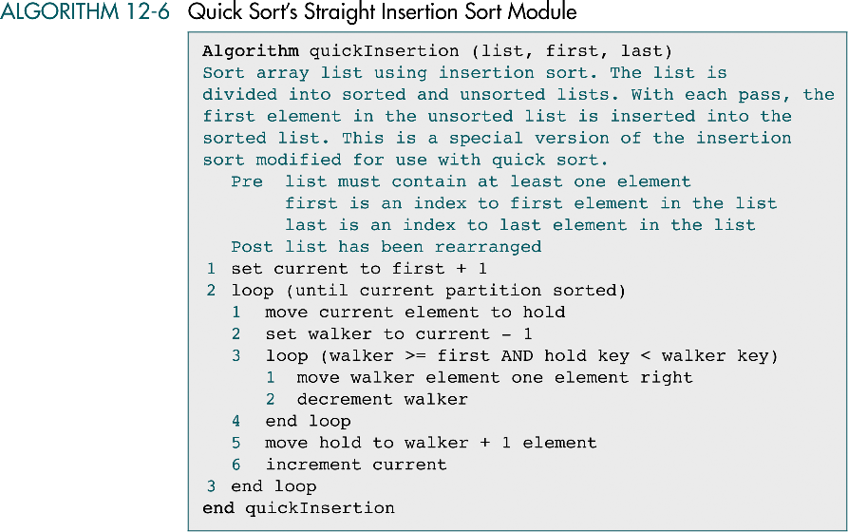

Slide 42
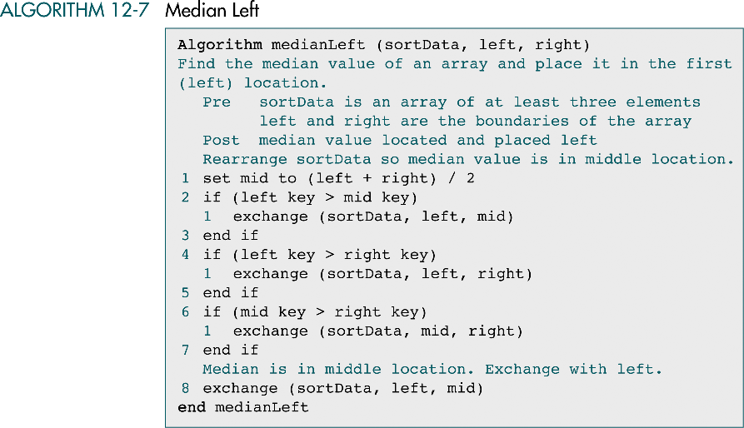

Slide 43
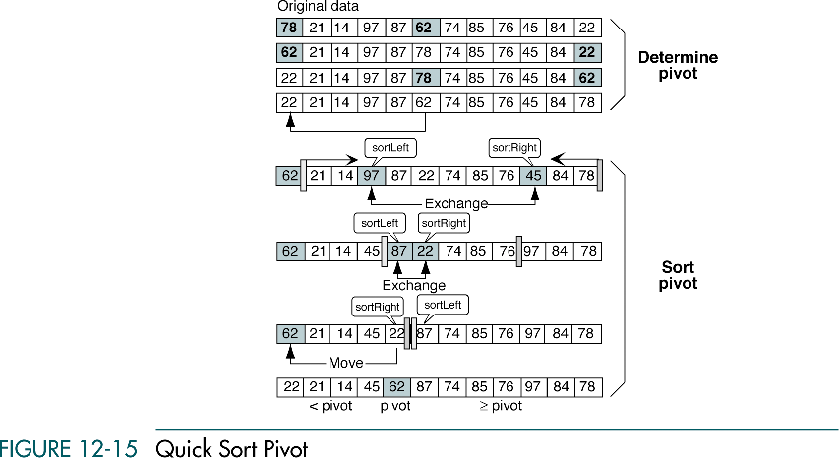

Slide 44
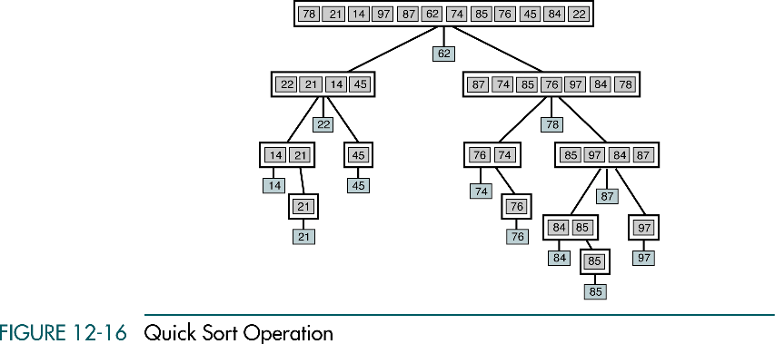

Slide 45
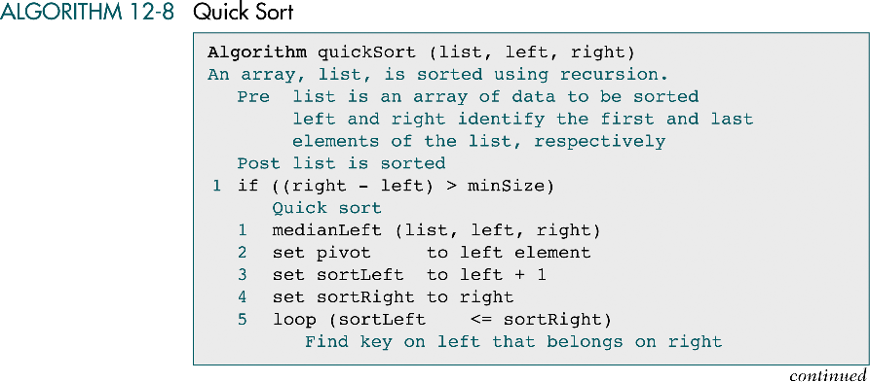

Slide 46
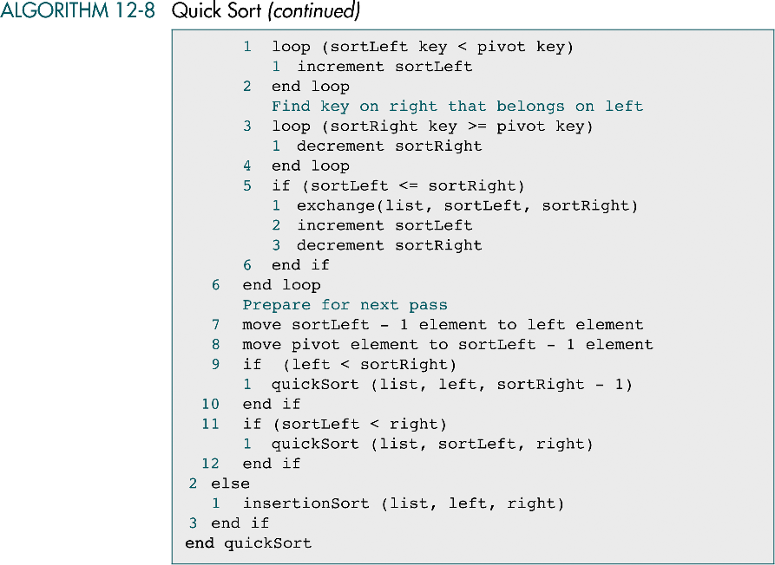

Slide 47
12-5 External Sorts
In external sorting portions of the data may be stored in secondary memory during the sorting process. Included in this section is a discussion of file merging and three external sort approaches-natural, balanced, and polyphase.
Merging Ordered Files
Merging Unordered Files
The Sorting Process
Sort Phase Revisited

Slide 48
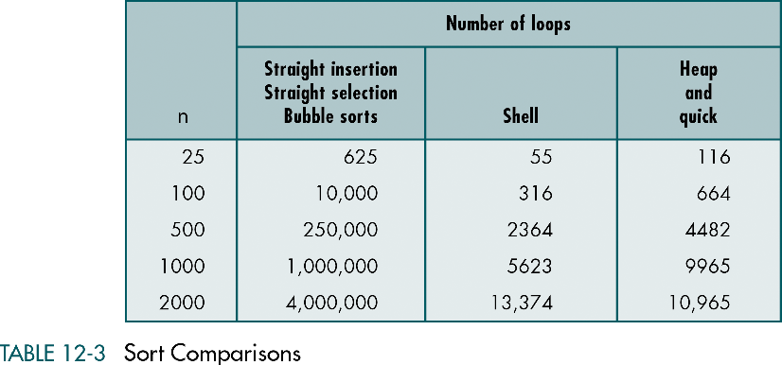

Slide 49
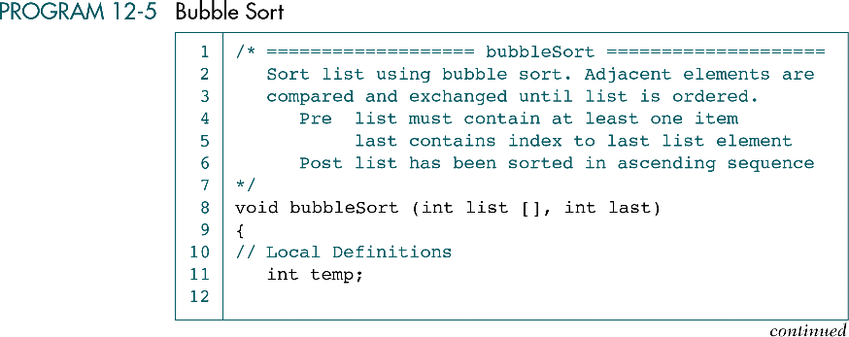

Slide 51
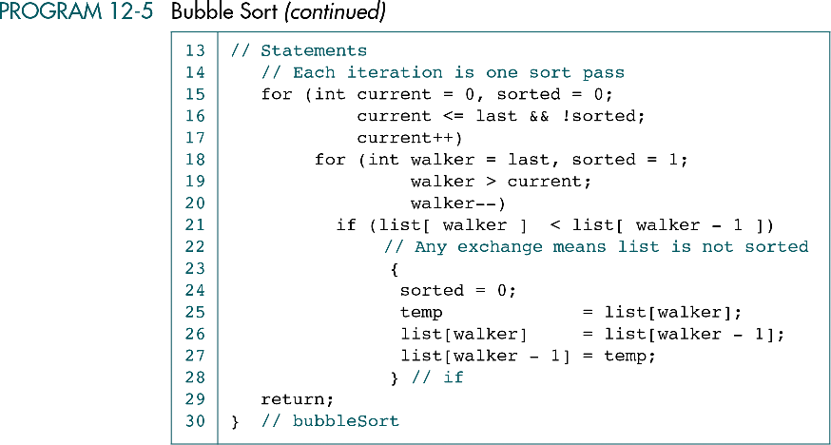

Slide 52
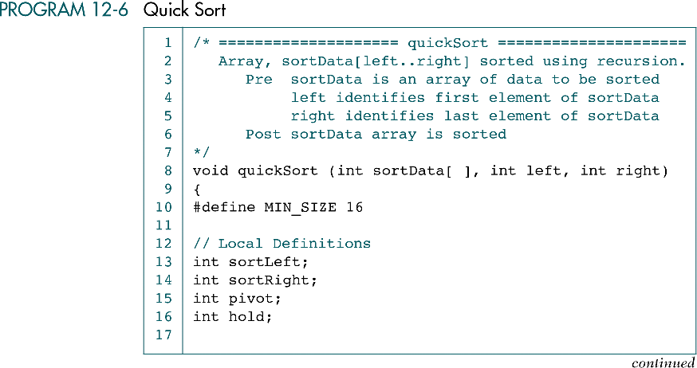

Slide 53
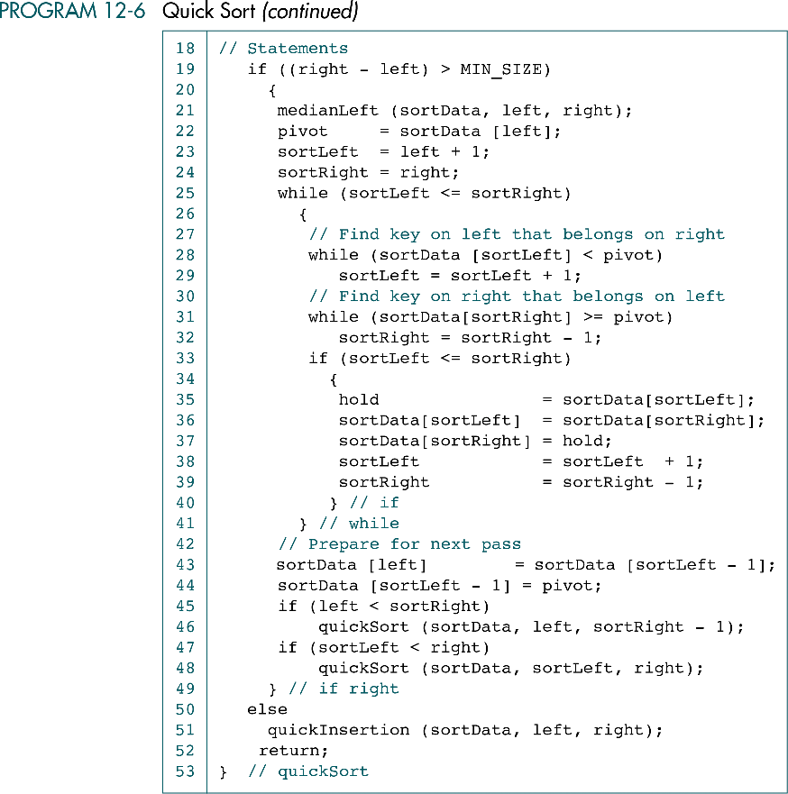

Slide 55
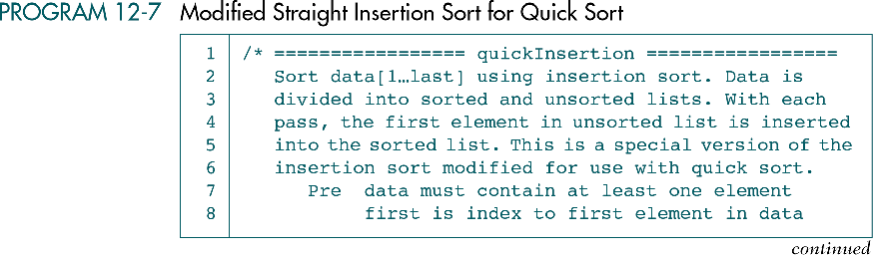

Slide 56
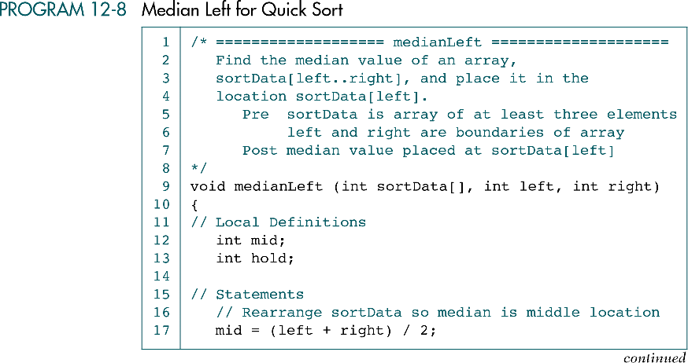

Slide 57
